Slide 1
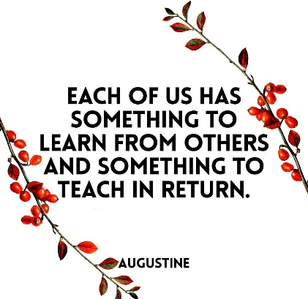
Educational
.
Advice from Jack Ma
Enjoy making mistakes
When you try it generates hope
Never give up
Finish something that you started
Don’t be scared of failure or setbacks
Respect yourself!
20-30 mistakes (risk) explore
30-40 will you work for yourself or someone else
40-50 focus on the things that you are good at
50-60 work for the young people
I want those who may sometimes fail, learn from the mistake, get up and try again
Discussion
Spend time caring for and considering others!
Focus will be on ….
Not only IQ (intelligence), but also
EQ (Ability to understand others)
LQ (Care for other’s success)
Respect others, as they may have something that they can offer or teach you
Analyse any weaknesses (in area you enjoy) that you have, as this is hope, these are opportunities
Feel proud and honored when you are able to help someone
…
Christopher Bauman – www.chrisbauman.com.au

Slide 2
1. Any mistake is a wonderful revenue for you ____________________________________________________________________________________________?
Advanced Question Words
2. The future is the competition of creativity / imagination / independent thinking ___________________________________________________________________________________________ ?
Beliefs
Have you been through any tough situations?
3. New technology will change every aspect of the world (share a piece of new technology) ___________________________________________________________________________________________ ?
You must have a unique and different way
4 Care about the success of others ___________________________________________________________________________________________ ?
5. Have you learnt anything from failure or rejection ___________________________________________________________________________________________ ?
Learn through mistakes
Create good circles
6. Why does Jack Ma like the Forrest Gump movie ___________________________________________________________________________________________ ?
Find
Dream the impossible dream
7. Who are the people that you can learn from (not only in your profession) ___________________________________________________________________________________________ ?
Complaining does not solve any problems
8. What can you contribute to others (everyone has something to teach) ____________________________________________________________________________________________ ?
Many of Jack Ma’s investors were his students
Opportunities are found in the places where people complain…. Why? Give an example
What are you optimistic about?
Christopher Bauman – www.chrisbauman.com.au

Slide 3
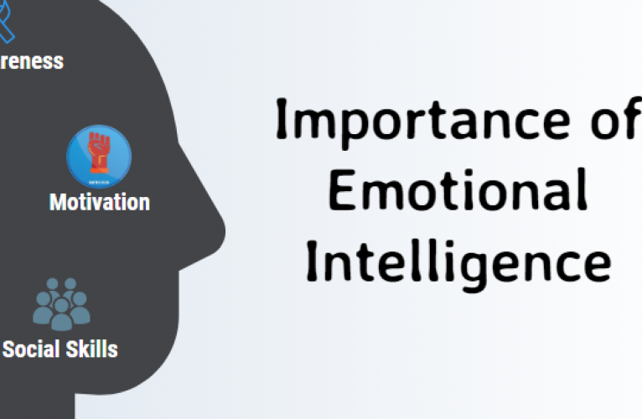
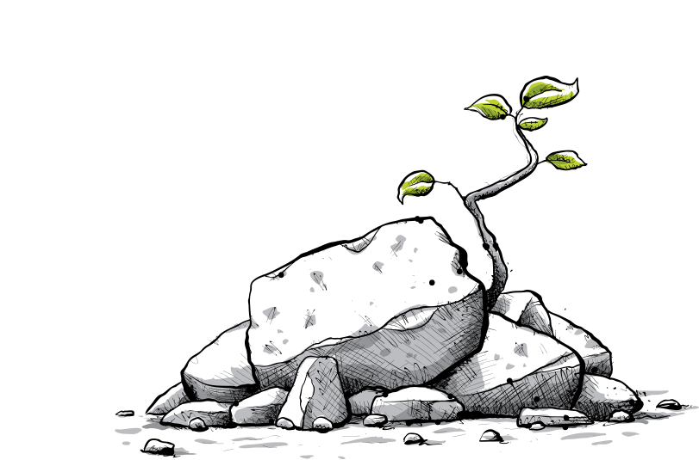
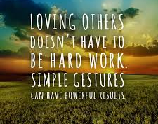

Slide 4
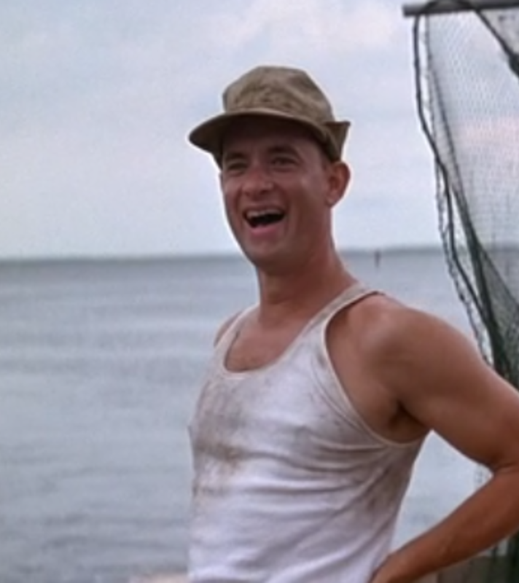
“Once in your life, try something. Work hard at something. Try to change. Nothing bad can happen.” Jack Ma

